Slide 1
Randomized Algorithms CS648
Lecture 24
Hashing – III
Probabilistic Method - III

Slide 2

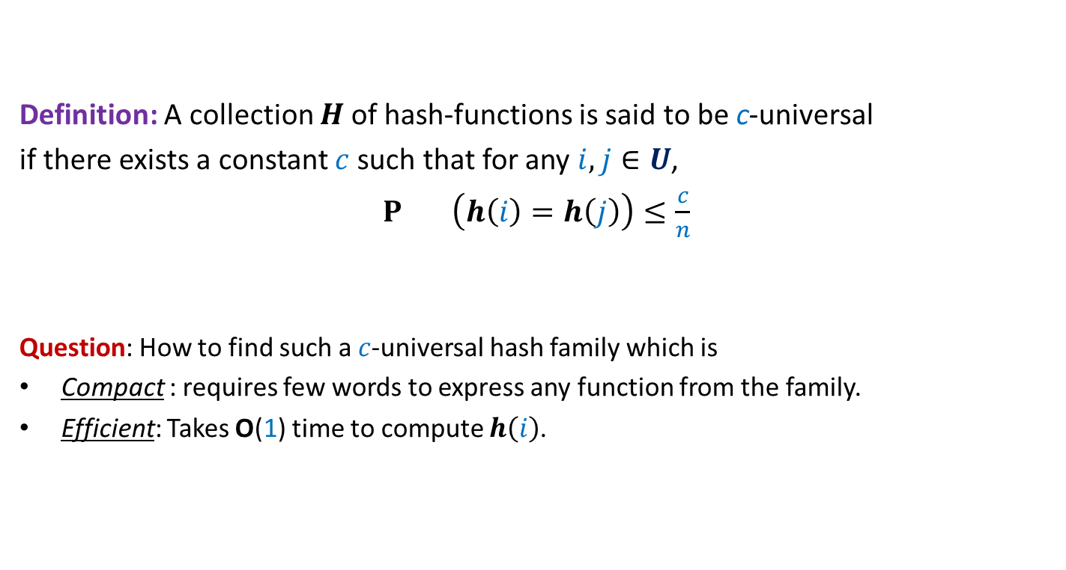
Universal Hash Family
Definition: A collection $H$of hash-functions is said to be c-universal
if there exists a constant $c$such that for any $i,j∈U$,
$P_{} \left(h\left(i\right)=h\left(j\right)\right)≤\frac{c}{n}$
Question: How to find such a $c$-universal hash family which is
Compact : requires few words to express any function from the family.
Efficient: Takes O(1) time to compute $h\left(i\right)$.
$$h∈_{r}H$$

Slide 3
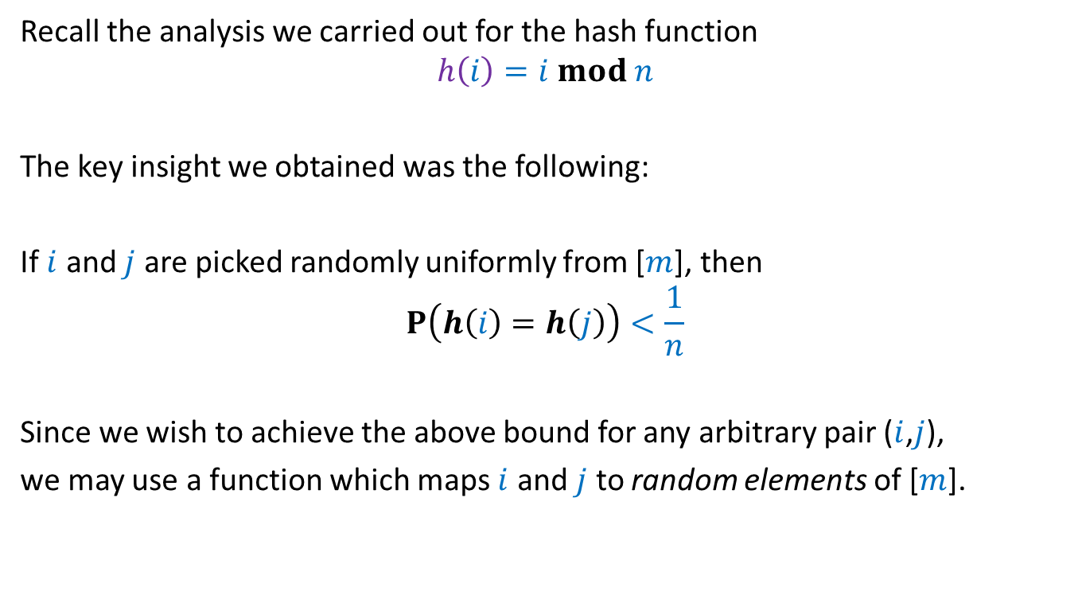
The intuition
Recall the analysis we carried out for the hash function
$$h\left(i\right)=i mod n$$
The key insight we obtained was the following:
If $i$ and $j$ are picked randomly uniformly from [$m$], then
$$P\left(h\left(i\right)=h\left(j\right)\right)<\frac{1}{n}$$
Since we wish to achieve the above bound for any arbitrary pair ($i$,$j$),
we may use a function which maps $i$ and $j$ to random elements of [$m$].

Slide 4

Revisiting mod operation
$p$ : a prime number
Assume $m=p−1$
$A$: {$1,2,…,p−1$}
$A^{∗}$: {$0,1,2,…,p−1$}

Slide 5
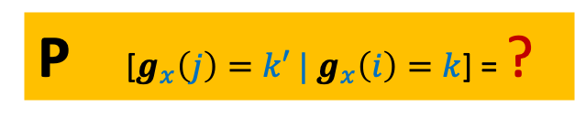

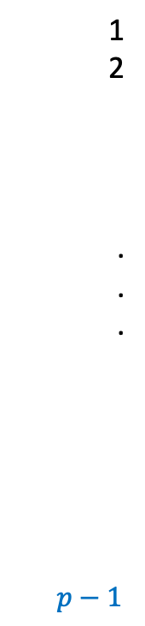
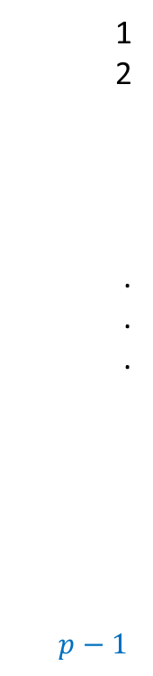





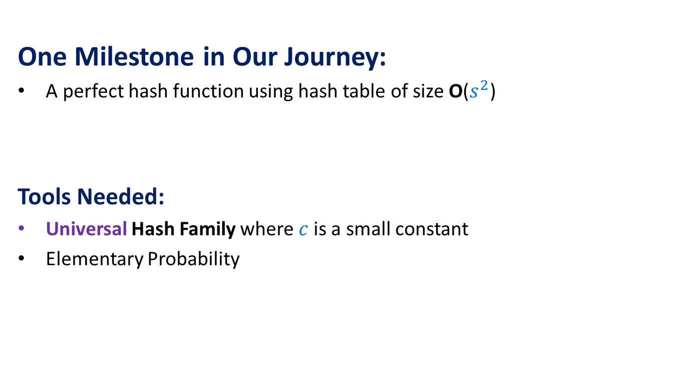


$$g_{x}\left(i\right)=ix mod p$$
1
2
.
.
.
$p−1$
1
2
.
.
.
$p−1$
$$g_{x}\left(i\right)=ix mod p$$
Fact:
If $x∈_{r}[1,…,p−1]$,
$g_{x}\left(i\right)$ is distributed randomly uniformly in$[1,…,p−1]$
Let $k$,$k^{′}∈$ $[1,…,p−1]$ and $k≠k′$
$$k′$$
$$g_{x}$$
$$i$$
$$j$$
$$k$$
P [$g_{x}\left(j\right)=k′ | g_{x}\left(i\right)=k$] = ?
$$∈\{0,1\}$$
$$x∈_{r}A$$

Slide 6
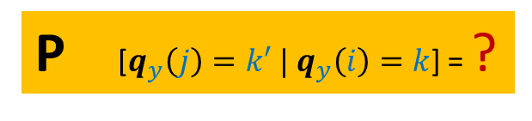
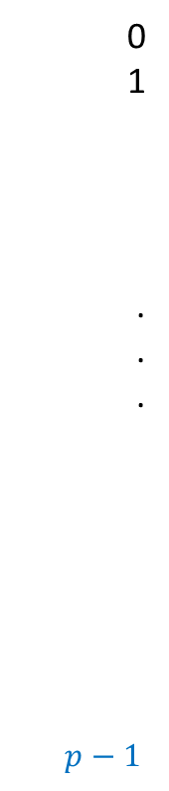





$q_{y}\left(i\right)=(i+y) mod$ $p$
1
2
.
.
.
$p−1$
0
1
.
.
.
$p−1$
$$q_{y}\left(i\right)=(i+y) mod p$$
Fact:
If $y∈_{r}[0,…,p−1]$,
$q_{y}\left(i\right)$ is distributed randomly uniformly in$[0,…,p−1]$
Let $k$,$k^{′}∈$ $[0,…,p−1]$ and $k≠k′$
$$k′$$
$$q_{y}$$
$$i$$
$$j$$
$$k$$
P [$q_{y}\left(j\right)=k′ | q_{y}\left(i\right)=k$] = ?
$$∈\{0,1\}$$
$$y∈_{r}A^{∗}$$

Slide 7
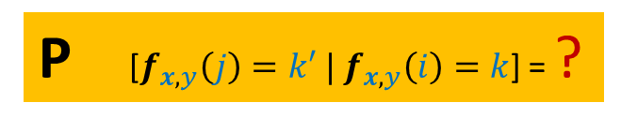




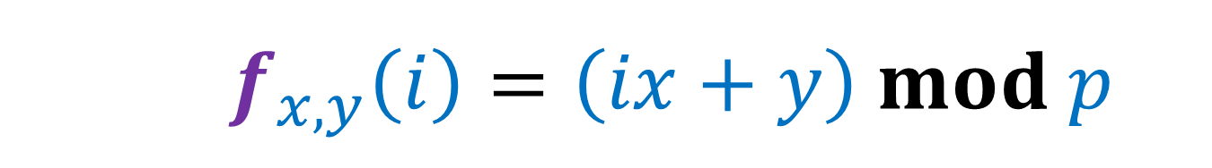




$$f_{x,y}\left(i\right)=\left(ix+y\right) mod p$$
1
2
.
.
.
$p−1$
0
1
.
.
.
$p−1$
$f_{x,y}\left(i\right)=(ix+y) mod p$
$=(ix mod p+y) mod p$
$=$ $q_{y}(g_{x}\left(i\right))$
$$k′$$
$$f_{x,y}$$
$g_{x}\left(i\right)=ix mod p$
$$i$$
$q_{y}\left(i\right)=(i+y) mod p$
$$j$$
$$k$$
P [$f_{x,y}\left(j\right)=k′ | f_{x,y}\left(i\right)=k$] = ?
$$x∈_{r}A$$
$$y∈_{r}A^{∗}$$

Slide 8







$$f_{x,y}\left(i\right)=\left(ix+y\right) mod p$$
1
2
.
.
.
$p−1$
1
2
.
.
.
$p−1$
0
1
.
.
.
$p−1$
$f_{x,y}\left(i\right)=(ix+y) mod p$
$=(ix mod p+y) mod p$
$=$ $q_{y}(g_{x}\left(i\right))$
$$x_{1}$$
$$y_{1}$$
$$g_{x}$$
$$q_{y}$$
$g_{x}\left(i\right)=ix mod p$
$$i$$
$q_{y}\left(i\right)=(i+y) mod p$
$$j$$
$$k$$

Slide 9


$$f_{x,y}\left(i\right)=\left(ix+y\right) mod p$$
1
2
.
.
.
$p−1$
1
2
.
.
.
$p−1$
0
1
.
.
.
$p−1$
$f_{x,y}\left(i\right)=(ix+y) mod p$
$=(ix mod p+y) mod p$
$=$ $q_{y}(g_{x}\left(i\right))$
$$x_{1}$$
$$y_{1}$$
$$g_{x}$$
$$q_{y}$$
$g_{x}\left(i\right)=ix mod p$
$$i$$
$q_{y}\left(i\right)=(i+y) mod p$
$$x_{2}$$
$$j$$
$$y_{2}$$
$$k$$

Slide 10







$$f_{x,y}\left(i\right)=\left(ix+y\right) mod p$$
$$j=\left(i+Δ\right) mod p$$
1
2
.
.
.
$p−1$
1
2
.
.
.
$p−1$
0
1
.
.
.
$p−1$
$f_{x,y}\left(i\right)=(ix+y) mod p$
$=(ix mod p+y) mod p$
$=$ $q_{y}(g_{x}\left(i\right))$
$f_{x_{ℓ},y_{ℓ}}\left(j\right)=$ ?
$$g_{x}$$
$$q_{y}$$
$g_{x}\left(i\right)=ix mod p$
$$i$$
$q_{y}\left(i\right)=(i+y) mod p$
$(k+Δ⋅x_{ℓ}) mod p$
$$j$$
$$k$$
Distributed uniformly over {$1,…,p−1$}
How is $j$ distributed?
There are {${(x}_{1},y_{1})$,…, ${(x}_{p−1},y_{p−1})$}
such that $f_{x_{ℓ},y_{ℓ}}\left(i\right)=k$

Slide 11



$$f_{x,y}\left(i\right)=\left(ix+y\right) mod p$$
$$j=\left(i+Δ\right) mod p$$
1
2
.
.
.
$p−1$
1
2
.
.
.
$p−1$
0
1
.
.
.
$p−1$
$f_{x,y}\left(i\right)=(ix+y) mod p$
$=(ix mod p+y) mod p$
$=$ $q_{y}(g_{x}\left(i\right))$
$f_{x_{ℓ},y_{ℓ}}\left(j\right)=$ ?
$$k′$$
$$g_{x}$$
$$q_{y}$$
$g_{x}\left(i\right)=ix mod p$
$$i$$
$q_{y}\left(i\right)=(i+y) mod p$
$(k+Δ⋅x_{ℓ}) mod p$
$$j$$
$$k$$
P [$f_{x,y}\left(j\right)=k′ | f_{x,y}\left(i\right)=k$] = ?
$$\frac{1}{p−1}$$
$$x∈_{r}A$$
$$y∈_{r}A^{∗}$$
There are {${(x}_{1},y_{1})$,…, ${(x}_{p−1},y_{p−1})$}
such that $f_{x_{ℓ},y_{ℓ}}\left(i\right)=k$

Slide 12

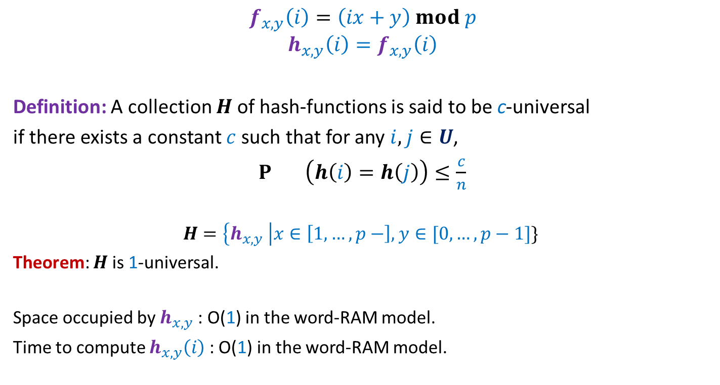

Universal Hash Family
$$f_{x,y}\left(i\right)=\left(ix+y\right) mod p$$
$$h_{x,y}\left(i\right)=f_{x,y}\left(i\right)$$
Definition: A collection $H$of hash-functions is said to be c-universal
if there exists a constant $c$such that for any $i,j∈U$,
$P_{} \left(h\left(i\right)=h\left(j\right)\right)≤\frac{c}{n}$
$$H=\left\{h_{x,y} \right|x∈\left[1,…,p−\right], y∈[0,…,p−1]\}$$
Theorem: $H$ is 1-universal.
Space occupied by $h_{x,y}$ : O(1) in the word-RAM model.
Time to compute $h_{x,y}\left(i\right)$ : O(1) in the word-RAM model.
$$mod n$$
$$h∈_{r}H$$

Slide 13
Probabilistic methods

Slide 14
Probabilistic methods
Methods that use
Probability theory or
Randomized algorithm
to prove deterministic combinatorial results

Slide 15
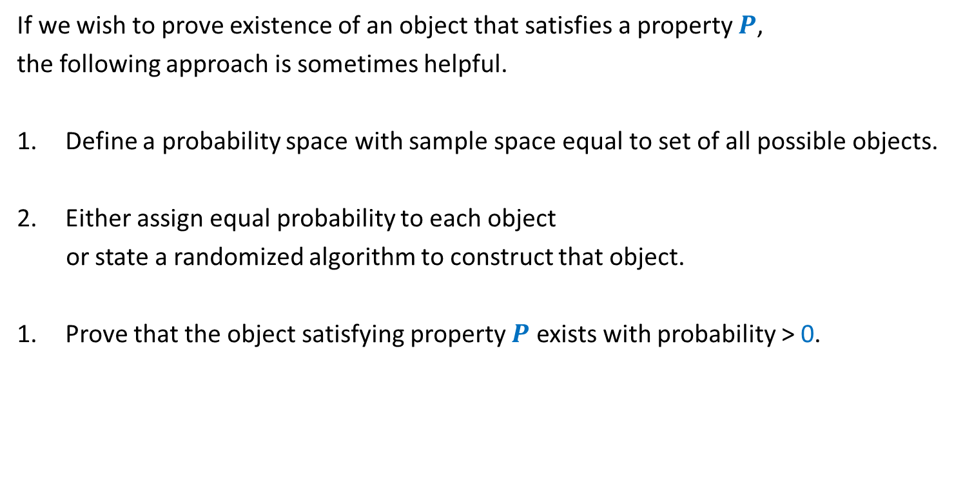
A common framework of using Probabilistic methods
If we wish to prove existence of an object that satisfies a property $P$,
the following approach is sometimes helpful.
Define a probability space with sample space equal to set of all possible objects.
Either assign equal probability to each object
or state a randomized algorithm to construct that object.
Prove that the object satisfying property $P$ exists with probability > 0.

Slide 16
problem 3 Large CUT in a graph

Slide 17
Undirected graph

Slide 18

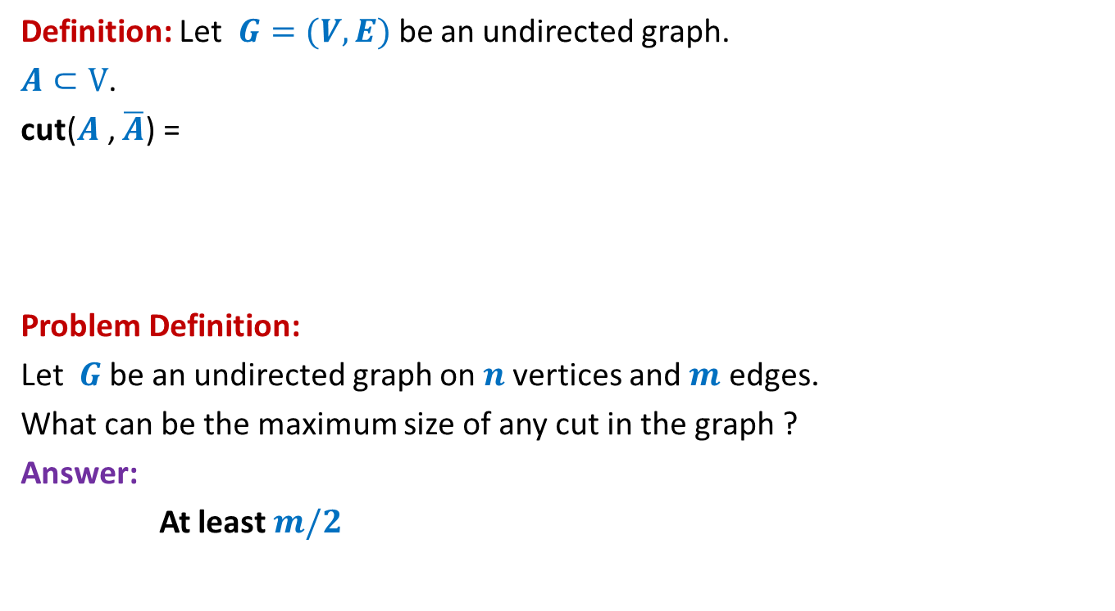
Large cut in a graph
Definition: Let $G=(V,E)$be an undirected graph.
$A⊂V$.
cut($A$, $\overline{A}$) =
Problem Definition:
Let $G$be an undirected graph on $n$vertices and $m$ edges.
What can be the maximum size of any cut in the graph ?
Answer:
At least $m/2$
{ $\left(u,v\right)∈E$) : $u∈A$, $v∈$ $\overline{A}$ or $u∈\overline{A}$, $v∈$ $A$}

Slide 19


Large cut in a graph
$$A$$
$$\overline{A}$$

Slide 20
Large cut in a graph
$$A$$
$$\overline{A}$$

Slide 21

Large cut in a graph
A randomized algorithm:
$A$←∅;
Add each vertex from $V$to $A$randomly independently with probability $\frac{1}{2}$.
Return the cut defined by $A$.

Slide 22

Large cut in a graph
$X$: size of cut ($A,\overline{A}$) returned by the randomized algorithm.
E[$X$] = ??
$$X_{e}:\left\{\begin{aligned}1 if e is present in the cut \\ 0 otherwise \end{aligned}\right.$$
$X=\sum_{e}{X_{e}}$
E[$X$] $=\sum_{e}{{E[X}_{e}]}$
$=\sum_{e}{{P(X}_{e}=1)}$

Slide 23









Large cut in a graph
$$A$$
$$\overline{A}$$
$$u$$
$$v$$
$$u$$
$$v$$
$$v$$
$$u$$
$$e$$
$$\frac{1}{4}$$
+
$$\frac{1}{4}$$

Slide 24

Large cut in a graph
$X$: size of cut ($A,\overline{A}$) returned by the randomized algorithm.
E[$X$] = ??
$$X_{e}:\left\{\begin{aligned}1 if e is present in the cut \\ 0 otherwise \end{aligned}\right.$$
$X=\sum_{e}{X_{e}}$
E[$X$] $=\sum_{e}{{E[X}_{e}]}$
$=\sum_{e}{{P(X}_{e}=1)}$
$=\sum_{e}{\frac{1}{2}}$
$=\frac{m}{2}$

Slide 25

Large cut in a graph
Using Fact 2,
there is a cut of size at least $\frac{m}{2}$ in every graph with $m$edges.

Slide 26
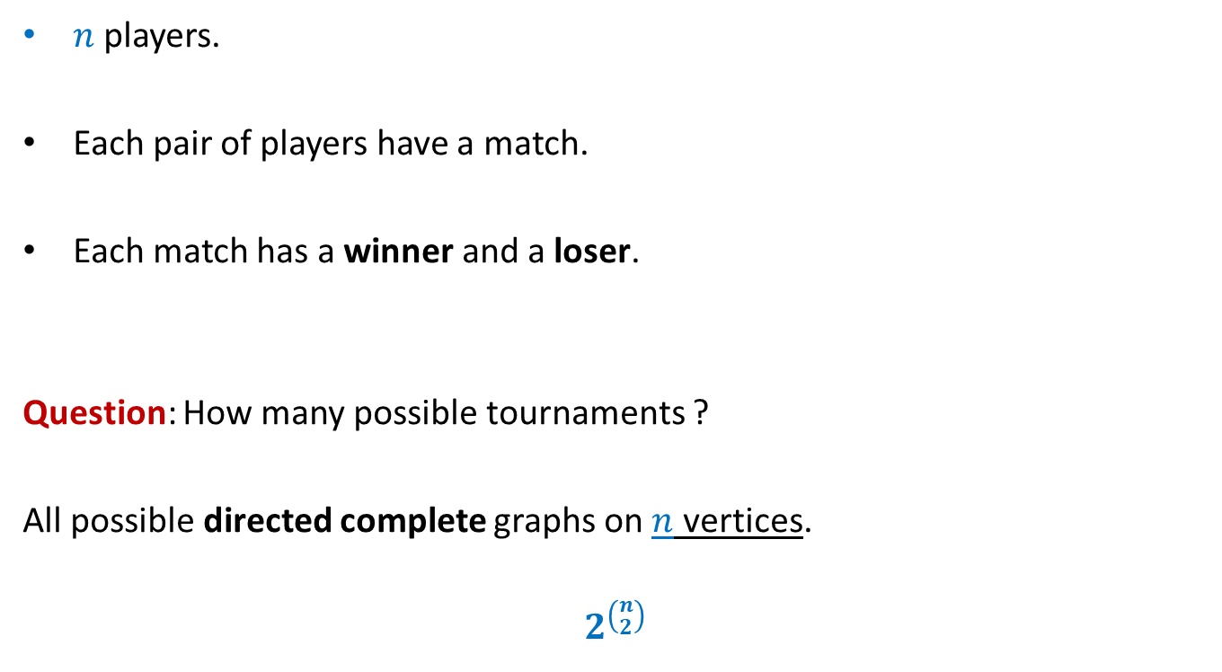
A tournament
$n$ players.
Each pair of players have a match.
Each match has a winner and a loser.
Question: How many possible tournaments ?
All possible directed complete graphs on $n$ vertices.
$$2^{\left({n \atop 2}\right)}$$

Slide 27




Problem 4
Problem: Let $k$ be any positive integer.
Prove that if
for each subset of $k$ players, there is a player who defeats them all.
Let us use the framework described just now to solve this problem.
It suffices if we can show the following:
$$\left({n \atop k}\right){\left(1−2^{−k}\right)}^{n−k}<1$$
, then there exists a tournament of $n$players s.t.
Property $D_{k}$
Sample space =
Set of all possible tournaments
Size of the set = $2^{\left({n \atop 2}\right)}$
Each tournament is equally likely.
A randomly picked tournament is not going to satisfy property $D_{k}$ with probability< $1$
We shall now establish this inequality systematically.

Slide 28
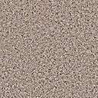









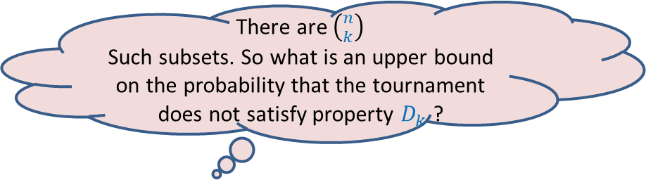
Problem 4
Problem: Let $k$ be any positive integer.
Prove that if
for each subset of $k$ players, there is a player who defeats them all.
$$\left({n \atop k}\right){\left(1−2^{−k}\right)}^{n−k}<1$$
, then there exists a tournament such that
Property $D_{k}$
Sample space =
Set of all possible tournaments
Size of the set = $2^{\left({n \atop 2}\right)}$
Each tournament is equally likely.
There are $\left({n \atop k}\right)$
Such subsets. So what is an upper bound on the probability that the tournament does not satisfy property $D_{k}$ ?
What is the probability that this player does not defeat all players of the set ?
What is the probability that this player defeats all players of the set ?
What is the probability that no player outside the set defeats all players of the set ?
Consider any player outside this set.
Consider any subset of $k$ players.
$$n−k$$
$$\left({n \atop k}\right)$$
$$2^{−k}$$
$$\left(1−2^{−k}\right)$$
$$<1$$
We are done ☺
$$k$$
Hint: Use Union theorem
$$n$$

Slide 29
problem 4 Sum free subset of large size

Slide 30


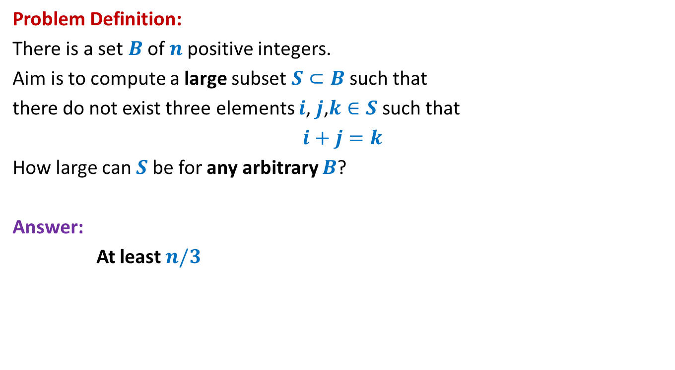



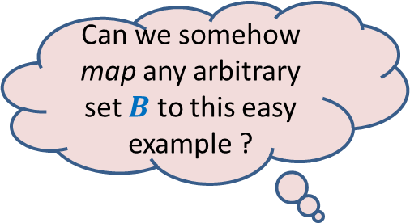
Large subset that is sum-free
Can we somehow map any arbitrary set $B$ to this easy example ?
Problem Definition:
There is a set $B$of $n$positive integers.
Aim is to compute a large subset $S⊂B$such that
there do not exist three elements $i$, $j$,$k∈S$ such that
$i+j=k$
How large can $S$be for any arbitrary $B$?
Answer:
At least $n/3$
Yes, by randomization
An easy example of $B$
Suppose $B=[1..n]$
$$n=3m$$
$m m+1$ … … $2m+1$
$1 2$ … … $3m$
$$S$$

Slide 31
Homework
Attempt the problem mentioned on the previous slide using the hint.

